Slide 1
Development of a searchable database of cryoablation simulations, for use in treatment planning
F. Edward Boas, MD, PhD
Memorial Sloan Kettering Cancer Center
SIR 2016

Slide 2
Financial disclosures
F. Edward Boas: co-founder of Claripacs, LLC.
Jeremy C. Durack: Scientific Advisory Board member and investor in Adient Medical.
Stephen B. Solomon: PI on a multicenter lung cryoablation trial sponsored by Galil; receives research support from AngioDynamics and GE Healthcare.
Hooman Yarmohammadi: co-PI on a multicenter lung cryoablation trial sponsored by Galil.

Slide 3
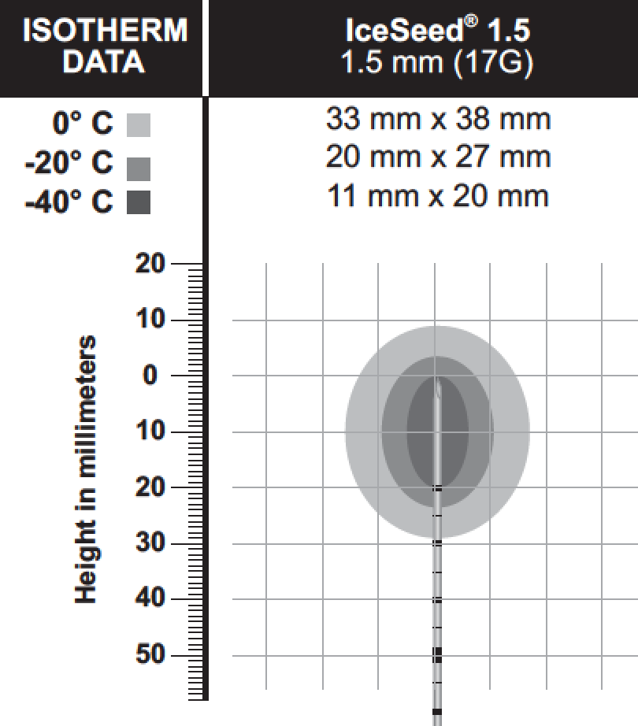
Cryoablation instructions for use
Room temperature gel
10 minute freeze, 5 minute thaw, 10 minute freeze
What about multiple probes?
Longer or shorter ablations?
Image credit: Galil Medical

Slide 4
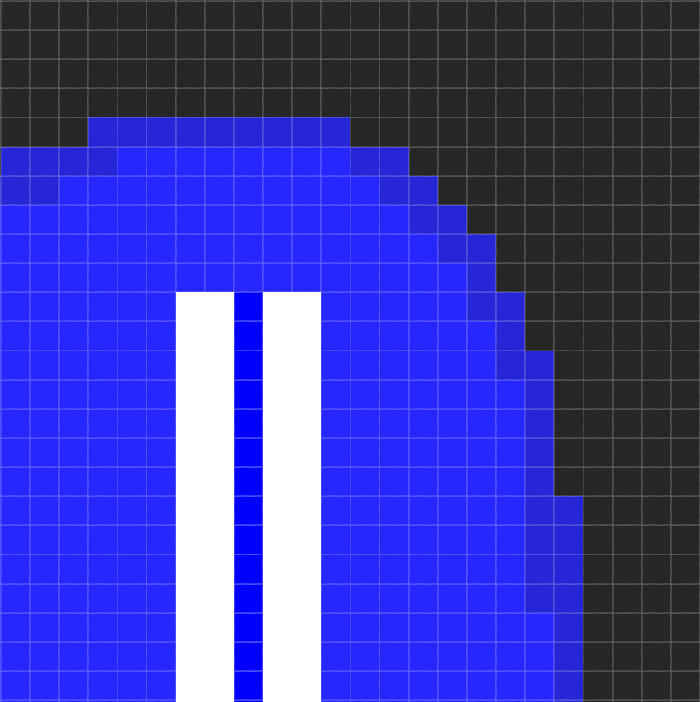
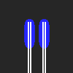
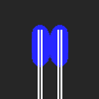

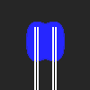

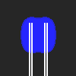
Cryoablation simulation
Pennes bioheat equation
3D grid, 1 mm voxels
Heat diffusion
Tissue perfusion
1 minute
2 minutes
3 minutes
5 minutes
7 minutes
10 minutes

Slide 5
Cryoablation simulation: Heat diffusion
1 mm
Diffusion depends on tissue- and temperature-specific:
thermal conductivity
heat capacity
water content

Slide 6
Cryoablation simulation: Tissue perfusion
Perfusion heats up tissue < 37°C
(and cools tissue > 37°C)
Kidney (high perfusion)
Liver (intermediate perfusion)
Muscle (low perfusion)
Fat (very low perfusion)

Slide 7
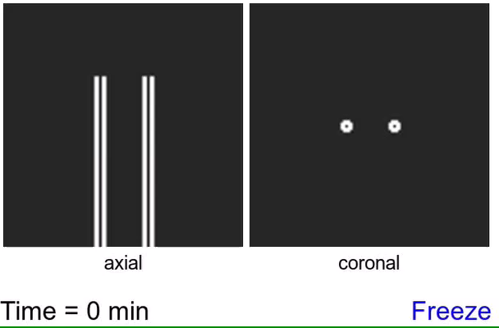
Cryoablation simulation
■ < –20°C
■ < 0°C
IceRod Plus probes in kidney
2 cm spacing
10 min freeze, 8 min thaw, 10 min freeze

Slide 8
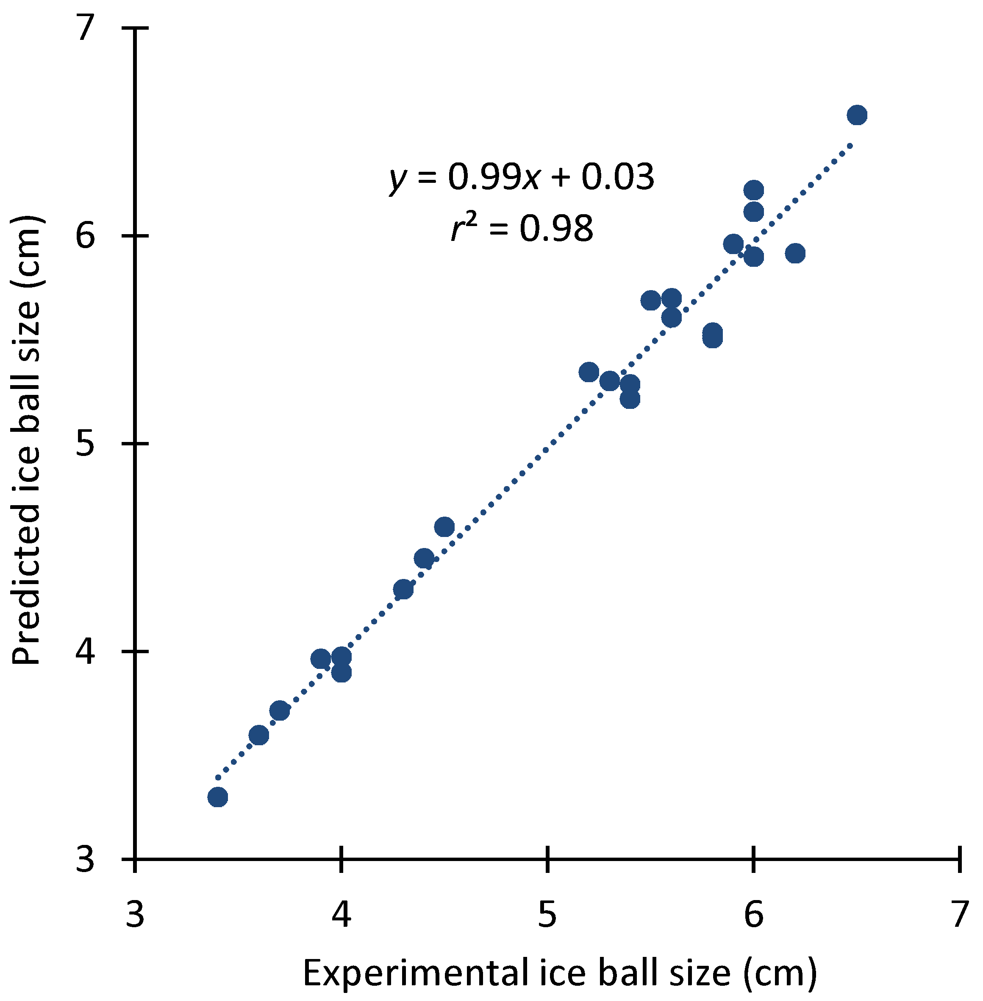
Accuracy: Predicting ice ball size in gel
1-4 probe ablations (IceRod Plus and IceSphere) in gel, with 1-2 cm spacing between probes
Average error: 1 mm
Maximum error: 3 mm
(26 measurements)
Gel data: Shah TT et al., 2016, Urology. In press.

Slide 9


Synergy
Multiple probe ablations are larger than you’d expect:
■ 1-probe ice ball
■ 2-probe ice ball
IceRod Plus in water, 2 cm spacing, 10 min freeze, 5 min thaw, 10 min freeze .

Slide 10
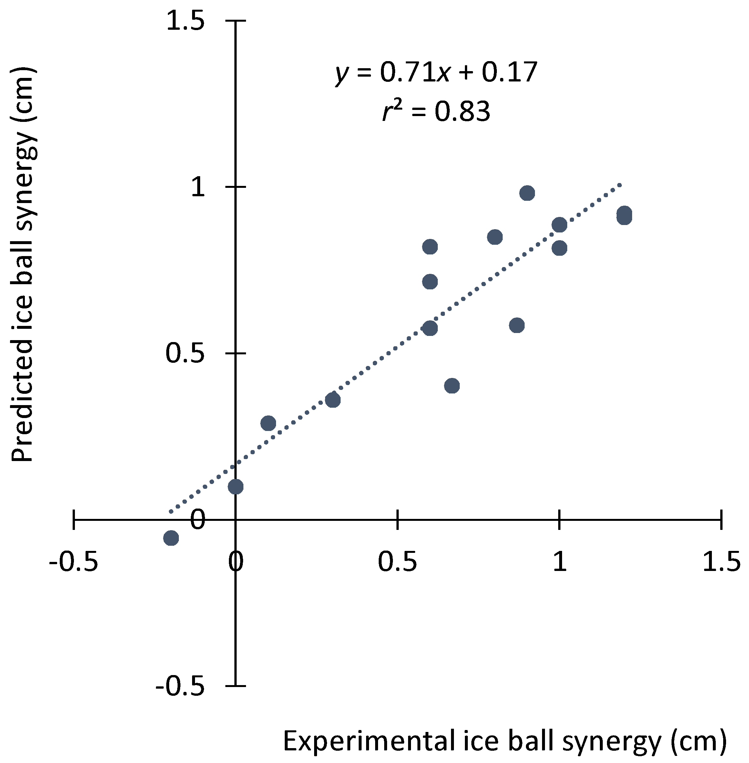
Accuracy: Predicting synergy
Up to 1.2 cm of synergy.
Accurately predicted by simulations.
More synergy seen with:
More ablation probes
Closer probe spacing

Slide 11
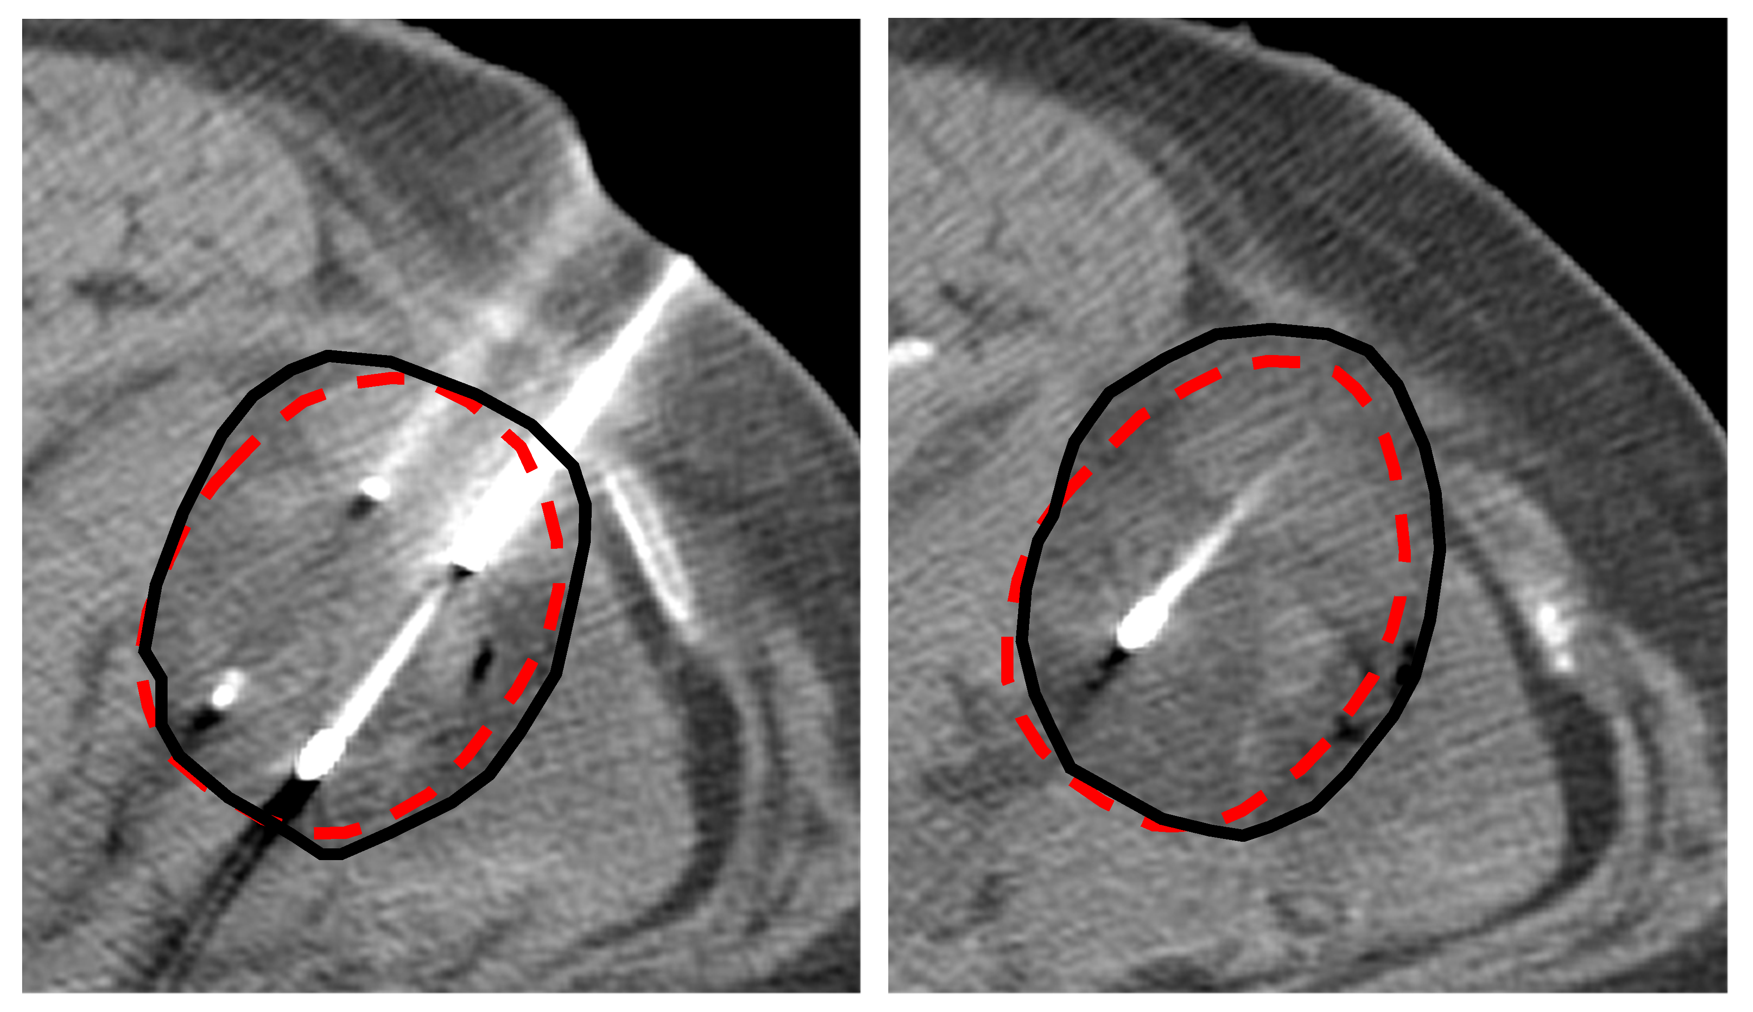
Accuracy: Predicting ice ball size in patients
Actual ice ball
Predicted ice ball
3-probe renal cryoablation.

Slide 12
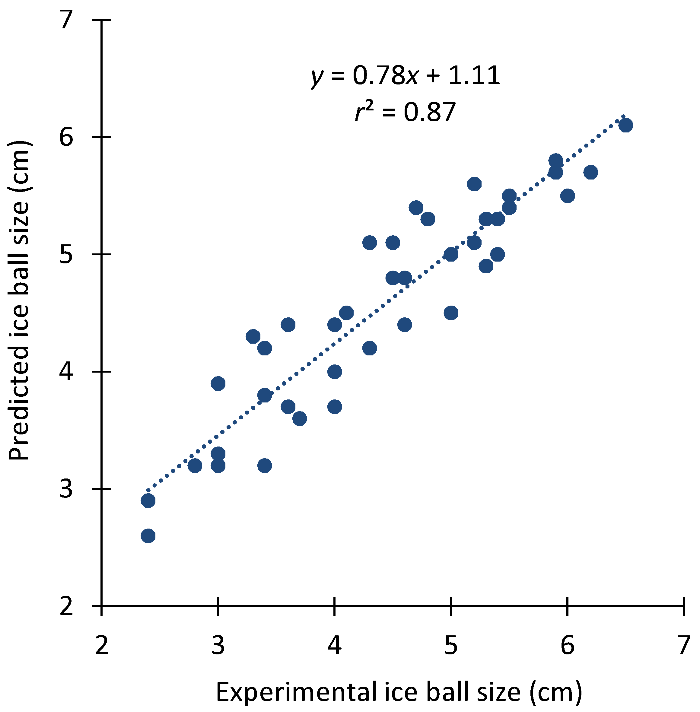
Accuracy: Predicting ice ball size in patients
1-6 probe clinical cryoablation procedures in kidney and liver.
Average error: 4 mm
Maximum error: 10 mm
(42 measurements).

Slide 13
Cryoablation planning
We can accurately predict the cryoablation zone.
Now let’s use this to plan cryoablation procedures!
Problem: 25 minute cryoablation takes 35 minutes to simulate.
Solution: Precompute a database of thousands of different probe configuations.

Slide 14
Cryoablation planning database
5670 simulations:
5 tissue types (kidney, liver, muscle, fat, and water)
2 probe types (Galil IceRod Plus 1.5 or IceSphere)
21 probe configurations (1-6 probes)
1-2 cm probe spacing
27 ablation schedules

Slide 15
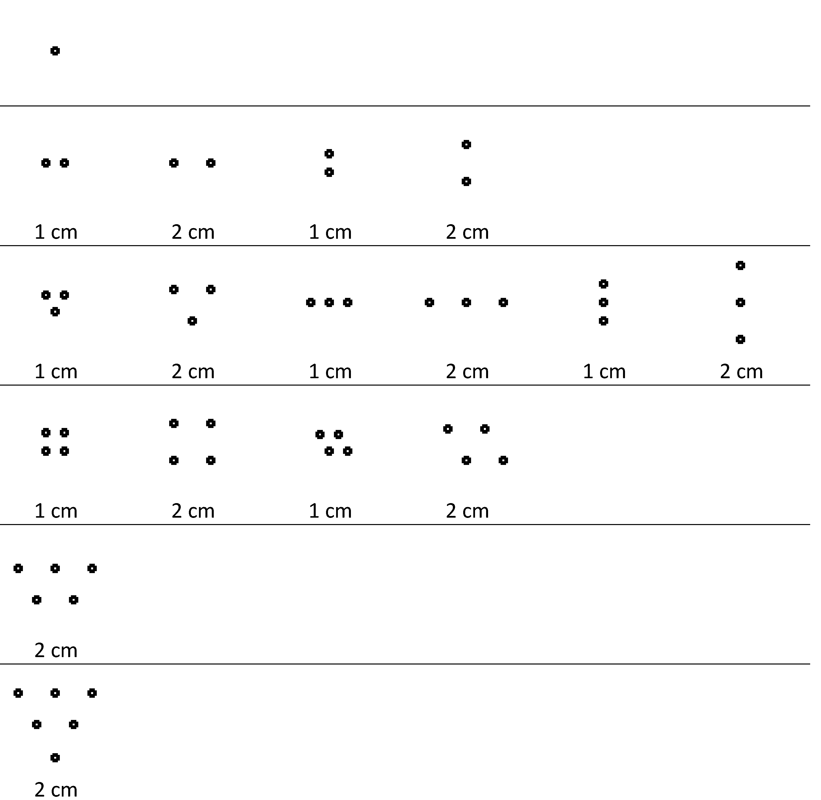
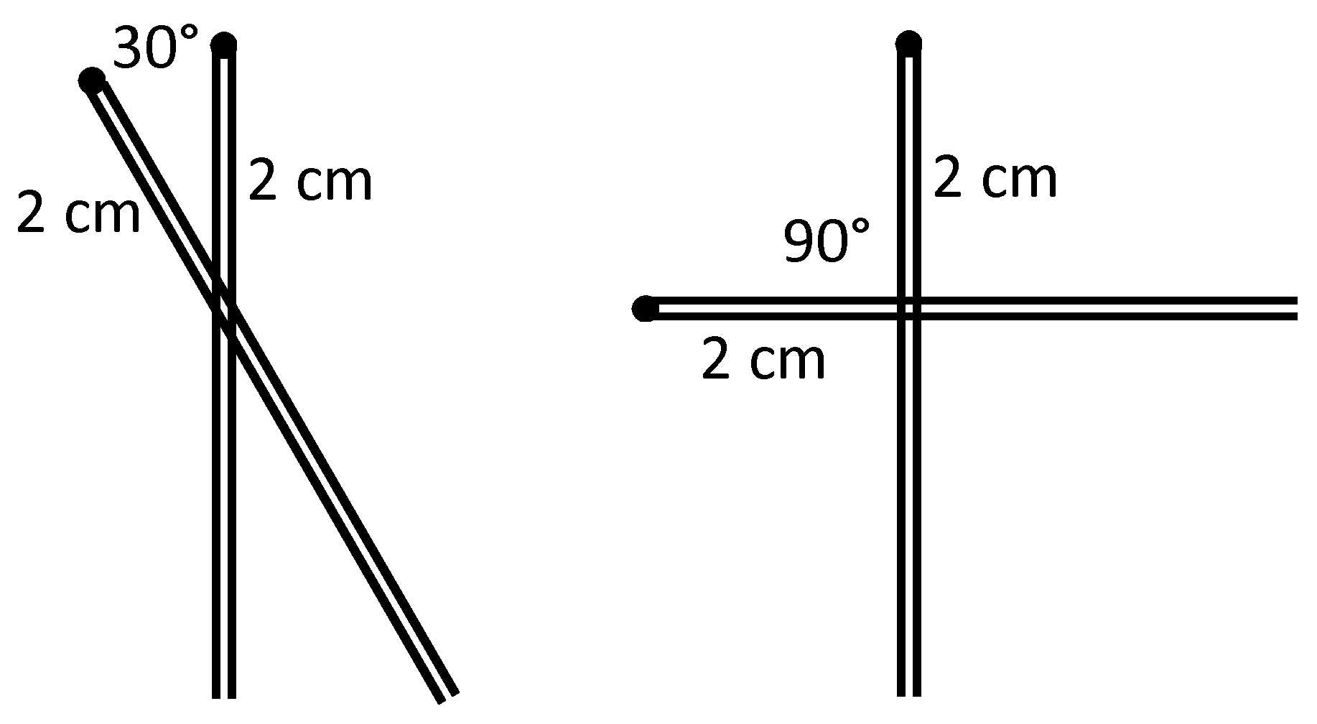
Probe configurations

Slide 16
Ablation schedules
1-20 min. freeze, in 1 min. increments
2 min. freeze, 1 min. passive thaw, 2 min. freeze
4 min. freeze, 2 min. passive thaw, 4 min. freeze
6 min. freeze, 3 min. passive thaw, 6 min. freeze
8 min. freeze, 4 min. passive thaw, 8 min. freeze
10 min. freeze, 5 min passive thaw, 10 or 15 or 20 min. freeze

Slide 17





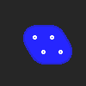
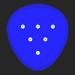



Cryoablation database coverage
Good coverage of a wide range of ice ball sizes and shapes up to 9.8 cm.
For any desired ice ball size a × b × c cm, where each dimension is between 3 and 6 cm, there is always a match in the database within 0.9 cm, and the average match is within 0.2 cm.

Slide 18
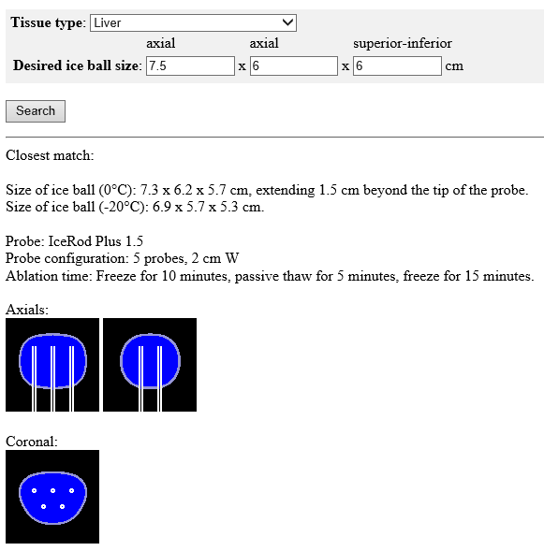
Web-based cryoablation planning tool
http://www.edboas.com/calc/cryo/index.html
Login: jvir
Password: cryoablation

Slide 19
Conclusion
Cryoablation planning software is:
Accurate
  1 mm error in gel, 4 mm error in patients
  model includes tissue-specific perfusion
Fast
  precomputed database
Comprehensive
  database contains 5670 procedures covering a wide range of geometries

Slide 20
Acknowledgements
Co-authors: Govindarajan Srimathveeravalli, Jeremy C. Durack, Elena A. Kaye, Joseph P. Erinjeri, Etay Ziv, Majid Maybody, Hooman Yarmohammadi, Stephen B. Solomon
Galil gel data: Vineel Vallapureddy, Sonja Foss, Luan Chan, Satish Ramadhyani, and Uri Arbel
This research was funded in part through an NIH/NCI Cancer Center Support Grant (P30 CA008748).

